Slide 1
How
Long Short-Term Memory (LSTM)
and
Recurrent Neural Networks (RNNs)
work
Brandon Rohrer
e2eml.school

Slide 2

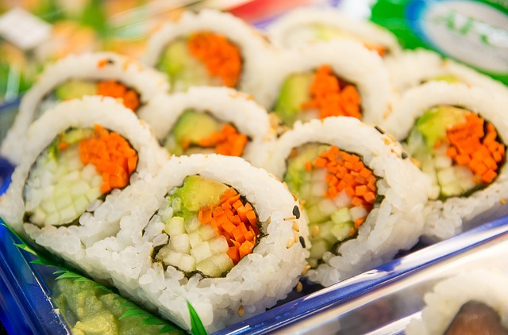
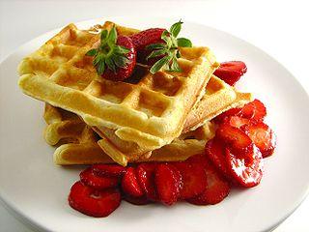
What’s for dinner?
day
of the week
pizza
month of the year
sushi
late meeting
waffles
e2eml.school

Slide 3
What’s for dinner?
pizza yesterday
pizza
sushi yesterday
sushi
waffles yesterday
waffles
e2eml.school

Slide 4
What’s for dinner?
predicted pizza for yesterday
pizza
predicted sushi for yesterday
predicted waffles for yesterday
sushi
pizza yesterday
sushi yesterday
waffles
waffles yesterday
e2eml.school

Slide 5
A vector is a list of values
High temperature
67
Weather vector
67
Low temperature
43
“High is 67 F.
Low is 43 F.
Wind is 13 mph.
.25 inches of rain.
Relative humidity is 83%.”
=
=
43
Wind speed
13
13
.25
Precipitation
.25
.83
Humidity
.83
e2eml.school

Slide 6
A vector is a list of values
Sunday
0
Day of week vector
Monday
0
0
0
=
Tuesday
1
=
1
“It’s Tuesday”
Wednesday
0
0
0
Thursday
0
0
Friday
0
0
Saturday
0
e2eml.school

Slide 7
A vector is a list of values
Dinner prediction vector
0
Pizza
0
=
=
“Tonight I think we’re going to have sushi.”
1
1
Sushi
0
0
Waffles
e2eml.school

Slide 8
predicted pizza for yesterday
pizza
predicted sushi for yesterday
predicted waffles for yesterday
sushi
pizza yesterday
sushi yesterday
waffles
waffles yesterday
e2eml.school

Slide 9
prediction for today
predictions for yesterday
dinner yesterday
e2eml.school

Slide 10
prediction
new information
e2eml.school

Slide 11
prediction
e2eml.school

Slide 12
Unrolled predictions
two days ago
yesterday
...
pizza
...
sushi
...
waffles
e2eml.school

Slide 13
Write a children’s book
Doug saw Jane.
Jane saw Spot.
Spot saw Doug.
...
Your dictionary is small: {Doug, Jane, Spot, saw, .}
e2eml.school

Slide 14
prediction
Jane
Doug
Spot
Jane
saw
Doug
.
Spot
Jane
saw
Doug
new information
Spot
.
saw
.
e2eml.school

Slide 15
prediction
Jane
Doug
Spot
Jane
saw
Doug
.
Spot
Jane
saw
Doug
new information
Spot
.
saw
.
e2eml.school

Slide 16
prediction
Jane
Doug
Spot
Jane
saw
Doug
.
Spot
Jane
saw
Doug
new information
Spot
.
saw
.
e2eml.school

Slide 17
prediction
Jane
Doug
Spot
Jane
saw
Doug
.
Spot
Jane
saw
Doug
new information
Spot
.
saw
.
e2eml.school

Slide 18
recurrent
neural
network
prediction
new information
e2eml.school

Slide 19
Hyperbolic tangent (tanh) squashing function
1.0
.5
-2.0
-1.5
-1.0
-.5
.5
1.0
1.5
2.0
-.5
-1.0
e2eml.school

Slide 20
tanh squashing function
1.0
.5
-2.0
-1.5
-1.0
-.5
.5
1.0
1.5
2.0
-.5
-1.0
Your number goes in here
e2eml.school

Slide 21
tanh squashing function
1.0
.5
-2.0
-1.5
-1.0
-.5
.5
1.0
1.5
2.0
-.5
-1.0
e2eml.school

Slide 22
tanh squashing function
The squashed version comes out here
1.0
.5
-2.0
-1.5
-1.0
-.5
.5
1.0
1.5
2.0
-.5
-1.0
e2eml.school

Slide 23
tanh squashing function
1.0
.5
-2.0
-1.5
-1.0
-.5
.5
1.0
1.5
2.0
-.5
-1.0
e2eml.school

Slide 24
tanh squashing function
1.0
.5
-2.0
-1.5
-1.0
-.5
.5
1.0
1.5
2.0
-.5
-1.0
e2eml.school

Slide 25
tanh squashing function
No matter what you start with, the answer stays between -1 and 1.
1.0
.5
-2.0
-1.5
-1.0
-.5
.5
1.0
1.5
2.0
-.5
-1.0
e2eml.school

Slide 26
recurrent
neural
network
prediction
new information
e2eml.school

Slide 27
Mistakes an RNN can make
Doug saw Doug.
Jane saw Spot saw Doug saw …
Spot. Doug. Jane.
e2eml.school

Slide 28
recurrent
neural
network
prediction
new information
e2eml.school

Slide 29
recurrent
neural
network
prediction
new information
e2eml.school

Slide 30
memory
prediction + memories
forgetting
memory
prediction
new information
e2eml.school

Slide 31
Plus junction: element-by-element addition
3
4
3 + 6
9
5
=
=
4 + 7
11
6
5 + 8
13
7
8
e2eml.school

Slide 32
Times junction: element-by-element multiplication
3
4
3 x 6
18
5
=
=
4 x 7
28
6
5 x 8
40
7
8
e2eml.school

Slide 33
Gating
0.8
0.8
Signal
0.8 x 1.0
0.8
0.8
=
=
0.8 x 0.5
0.4
1.0
0.8 x 0.0
0.0
On / Off
gating
0.5
0.0
e2eml.school

Slide 34
Logistic (sigmoid) squashing function
No matter what you start with, the answer stays between 0 and 1.
1.0
.5
-2.0
-1.0
1.0
2.0
e2eml.school

Slide 35
memory
prediction and memories
forgetting
memory
prediction
new information
e2eml.school

Slide 36
memory
prediction
selection
collected possibilities
forgetting
memory
new information
possibilities
e2eml.school

Slide 37
long
short-term
memory
prediction
selection
collected possibilities
forgetting
memory
filtered possibilities
ignoring
new information
possibilities
e2eml.school

Slide 38
long
short-term
memory
prediction
selection
collected possibilities
forgetting
memory
filtered possibilities
ignoring
Jane saw Spot.
Doug …
possibilities
e2eml.school

Slide 39
long
short-term
memory
prediction
selection
Doug,
Jane,
Spot
collected possibilities
forgetting
memory
filtered possibilities
ignoring
Jane saw Spot.
Doug …
possibilities
e2eml.school

Slide 40
long
short-term
memory
prediction
selection
Doug,
Jane,
Spot
collected possibilities
forgetting
memory
filtered possibilities
ignoring
Jane saw Spot.
Doug …
saw,
Doug
e2eml.school

Slide 41
long
short-term
memory
prediction
selection
Doug,
Jane,
Spot
collected possibilities
forgetting
memory
saw,
Doug
ignoring
Jane saw Spot.
Doug …
saw,
Doug
e2eml.school

Slide 42
long
short-term
memory
prediction
selection
Doug,
Jane,
Spot
saw,
Doug
forgetting
memory
saw,
Doug
ignoring
Jane saw Spot.
Doug …
saw,
Doug
e2eml.school

Slide 43
long
short-term
memory
saw
selection
Doug,
Jane,
Spot
saw,
Doug
forgetting
memory
saw,
Doug
ignoring
Jane saw Spot.
Doug …
saw,
Doug
e2eml.school

Slide 44
long
short-term
memory
prediction
selection
collected possibilities
forgetting
memory
filtered possibilities
ignoring
new information
possibilities
e2eml.school

Slide 45
long
short-term
memory
prediction
selection
saw
collected possibilities
forgetting
memory
filtered possibilities
ignoring
new information
possibilities
e2eml.school

Slide 46
long
short-term
memory
prediction
selection
saw
collected possibilities
forgetting
memory
filtered possibilities
ignoring
Jane saw Spot.
Doug saw …
possibilities
e2eml.school

Slide 47
long
short-term
memory
prediction
selection
saw,
Doug
saw
collected possibilities
forgetting
memory
filtered possibilities
ignoring
Jane saw Spot.
Doug saw …
possibilities
e2eml.school

Slide 48
long
short-term
memory
prediction
selection
saw,
Doug
saw
collected possibilities
forgetting
Doug
filtered possibilities
ignoring
Jane saw Spot.
Doug saw …
possibilities
e2eml.school

Slide 49
long
short-term
memory
prediction
selection
saw,
Doug
saw
collected possibilities
forgetting
Doug
filtered possibilities
ignoring
Jane saw Spot.
Doug saw …
Doug,
Jane,
Spot
e2eml.school

Slide 50
long
short-term
memory
prediction
selection
saw,
Doug
saw
collected possibilities
forgetting
Doug
Doug,
Jane,
Spot
ignoring
Jane saw Spot.
Doug saw …
Doug,
Jane,
Spot
e2eml.school

Slide 51
long
short-term
memory
prediction
selection
saw,
Doug
saw
Jane,
Spot
forgetting
Doug
Doug,
Jane,
Spot
ignoring
Jane saw Spot.
Doug saw …
Doug,
Jane,
Spot
e2eml.school

Slide 52
long
short-term
memory
Jane,
Spot
selection
saw,
Doug
saw
Jane,
Spot
forgetting
Doug
Doug,
Jane,
Spot
ignoring
Jane saw Spot.
Doug saw …
Doug,
Jane,
Spot
e2eml.school

Slide 53
Sequential patterns
Text
Speech
Audio
Video
Physical processes
Anything embedded in time (almost everything)
e2eml.school

Slide 54
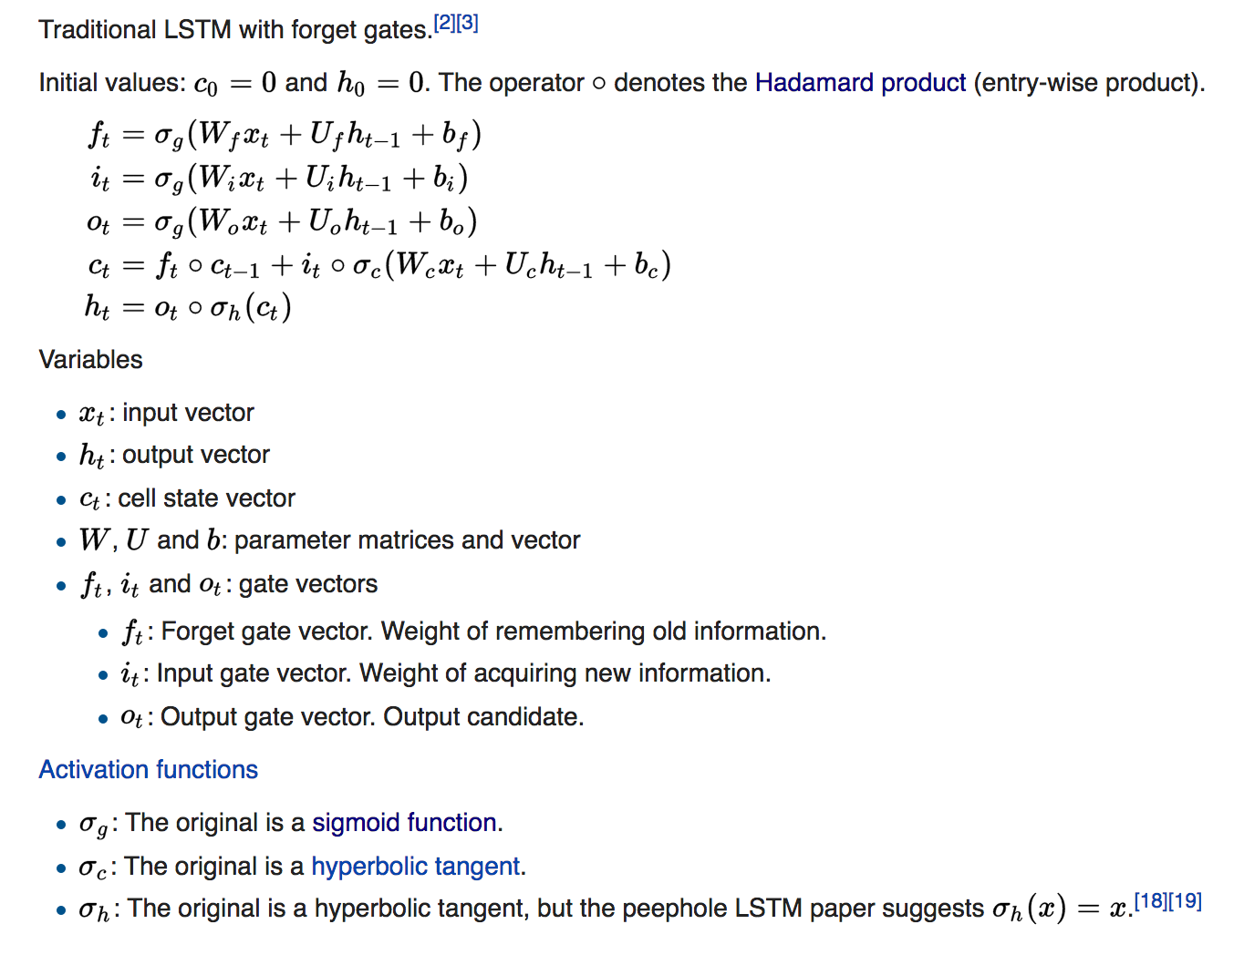
e2eml.school

Slide 55
Resources
Chris Olah’s tutorial
Andrej Karpathy’s
Blog post
RNN code
Stanford CS231n lecture
The DeepLearning 4J tutorial has some helpful discussion and a longer list of good resources.
How Neural Networks Work [video]
e2eml.school

Slide 56
Credits (all images CC0)
Pizza image
Sushi image
Waffles image
e2eml.school

